Slide 1
Presentation - Nature Inspired Optimization Of Video Popularity Prediction
Mentor :-
Ms. Neeti Sangwan
Presented by :-
Manan Arya 01996303116 IT(E)
Saransh Taneja 40696303116 IT(E)
Ashish Dagar 00696303116 IT(E)
Ankit Kumar 40396303116 IT(E)

Slide 2
Introduction
Online Content like articles,images ,video etc. is piling or increasing each day hence our aim is to use statistical mechanisms(regression) in order to predict the popularity of the content.
The basic idea includes optimizing feature selection using nature inspired algorithms and various other techniques; comparing all the techniques would help us reach the best possible solution.

Slide 3
Why Nature Inspired Algorithms
Retrieving data from videos is computationally very expensive and time consuming. Thus, the data available at any point of time is quite minimal and feature selection using usual algorithms is tough.
Improving the feature selection process along with the success of nature inspired algorithms over the years is the sole motivation for using these algorithms.

Slide 4
Genetic Algorithm
A genetic algorithm is a search heuristic that is inspired by Charles Darwin’s theory of natural evolution. This algorithm reflects the process of natural selection where the fittest individuals are selected to produce offspring of the next generation.
Genetic algorithms are mainly used for feature selection and optimization of other supervised and unsupervised algorithms.

Slide 5
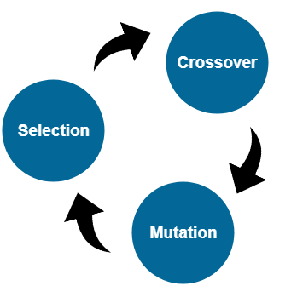
Stages Of Genetic Algorithm

Slide 6
Results Of Genetic Algorithm
Thirty generations of genetic algorithm and their corresponding results were analysed, after writing the code for the three functions namely selection based on fitness, crossover and mutation. In order to have a better analysis two separate curves depicting scores of best and average case chromosome score were plotted.

Slide 7
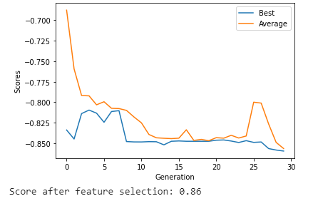
Result Of GA

Slide 8
Particle Swarm Optimization
Particle swarm optimization (PSO) is a population based stochastic optimization technique developed by two American scholars in 1995, inspired by social behaviour of bird flocking or fish schooling. PSO shares many similarities with evolutionary computation techniques such as Genetic Algorithms (GA). The system is initialized with a population of random solutions and searches for optima by updating generations.

Slide 9
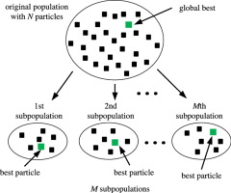
Basic Methodology Of PSO

Slide 10
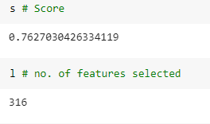
Results Of PSO

Slide 11
Bat Optimization Algorithm
Bat-inspired algorithm is a metaheuristic optimization algorithm developed by Xin-She Yang in 2010. This bat algorithm is based on the echolocation behaviour of microbats with varying pulse rates of emission and loudness. The idealization of the echolocation of microbats can be summarized as follows: Each virtual bat flies randomly with a velocity v_{i} at position (solution) x_{i} with a varying frequency or wavelength and loudness A_{i}

Slide 12
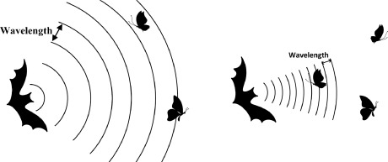
Bat Algorithm Inspiration

Slide 13
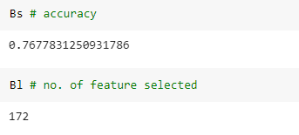
Results Of Bat Optimization

Slide 14
Dragonfly Algorithm
The main inspiration of the Dragonfly Algorithm (DA) algorithm originates from static and dynamic swarming behaviours. These two swarming behaviours are very similar to the two main phases of optimization using meta-heuristics: exploration and exploitation. Dragonflies create sub swarms and fly over different areas in a static swarm, which is the main objective of the exploration phase. In the static swarm, however, dragonflies fly in bigger swarms and along one direction, which is favourable in the exploitation phase.

Slide 15
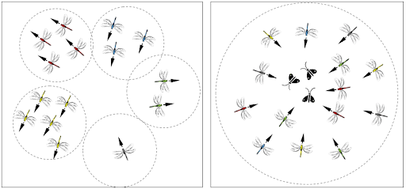
Dragon Fly Algorithm principles

Slide 16
Conclusion
Thus we conclude that the genetic algorithm which ensures the survival of the fittest and is biased towards exploitation performs better than other exploration heavy algorithms. Thus we were successful in comparing all the techniques and proposing the way forward.

